Slide 1
ADO.NET
Data Access and Manipulation
Asst.Prof.Dr.Derya BİRANT
329 - Windows Programming

Slide 2
Contents
1
What is ADO.NET?
2
ADO.NET Fundamentals
3
ADO.NET Architecture
4
ADO.NET Data Providers
5
The ADO.NET Namespace
6
Connection Strings
7
The Command Class

Slide 3
Definitions
Database (DB): a persistent store of data in a compact, secure, easy-and-fast-to-retrieve form.
Database Management System (DBMS): a database engine plus user interfaces and other supporting software.
DBMS Examples: Oracle, DB2 (IBM), Sybase, Informix, Microsoft SQL Server, Microsoft Access, MySQL (public domain), …
Database Server: a DBMS that provides data to its remote clients.
Database Table: data are stored in a database as “tables”. Each row of a table is called a record, each column of a table is called an attribute.
Database Schema: meta data for databases, defining tables and their attributes.

Slide 4
SQL
SQL (Structured Query Language) is a standardized language for accessing and manipulating databases.
The Select-From-Where Clause:
Select Office From PhoneBook Where Name=’Tom’;
Three Parts of SQL:
  DDL - Data Definition Language: table creation, alteration and drop.
  DML - Data Manipulation Language: inserting, deleting, updating, …
  Query - data retrieval
PhoneBook (Database Table Name)
Name | Office | Home | Cell
Tom | 330-972-5809 | 330-888-8888 | 330-168-8888
John | 330-972-7777 | 330-777-7777 | 330-168-7777
… | … | … | …

Slide 5
SQL Example
CREATE DATABASE pubs;
CREATE TABLE authors
(
au_id varchar(11) NOT NULL,
au_lname varchar(40) NOT NULL,
au_fname varchar(20) NOT NULL,
phone char(12) NOT NULL DEFAULT 'UNKNOWN',
address varchar(40) NULL,
city varchar(20) NULL,
state char(2) NULL,
zip char(5) NULL,
contract bit NOT NULL,
PRIMARY KEY(au_id)
);
insert into authors
values('409-56-7008', 'Bennet', 'Abraham', '415 658-9932',
'6223 Bateman St.', 'Berkeley', 'CA', '94705', 1);

Slide 6

SQL Server
By Microsoft
Needs runtime license
Best fit for .NET
Features and Free version: SQL Server Express
http://www.microsoft.com/sqlserver/en/us/default.aspx
Next Release: SQL SERVER 2012

Slide 7
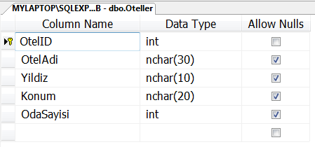
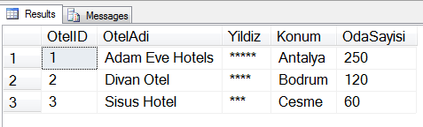
Let’s Do It!
Create OtelDB database
Create Oteller table
Insert several rows

Slide 8
What is ADO.NET?
The .NET Framework includes its own data access technology: ADO.NET
ADO.NET consists of managed classes that allow .NET applications to connect to data sources (usually relational databases), execute commands, and manage data.

Slide 9

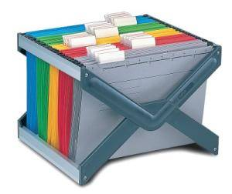

ADO.NET
Developers use ADO.NET data classes
  to interact with relational databases
  to interact with the file system
  to read XML documents
ADO.NET deals with the challenge of different data sources.

Slide 10


ADO.NET Fundamentals
Programmers use a generic set of objects no matter what the underlying data source is.
For example:
  You can use the same connection class
    to retrieve a record from an Oracle database
    to tackle the task with SQL Server
    …

Slide 11
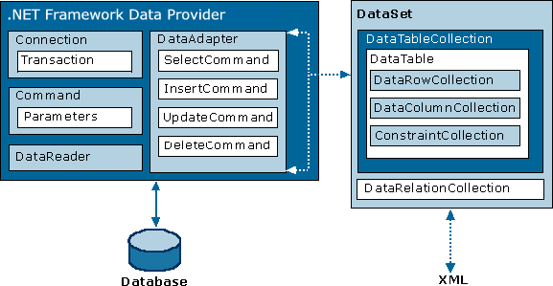
ADO.NET Architecture
ADO.NET uses a multilayered architecture that revolves around a few key concepts, such as Connection, Command, and DataSet objects.

Slide 12
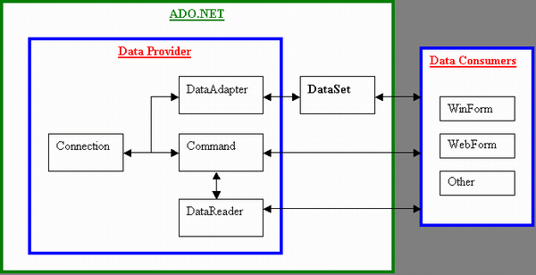
ADO.NET Architecture
ADO.NET allows you to write the data access code in windows applications that you write for
  client-server desktop applications, or
  single-user applications that connect to a local database.

Slide 13
Dataset
Stores the data you download from your data source.
The DataSet is made up of tabular sets of data, similar to a database.
A DataSet is essentially an offline database.
You connect to the data source and download your data to the DataSet.
The DataSet includes commands for accessing the data.
Many controls can work with DataSets.

Slide 14
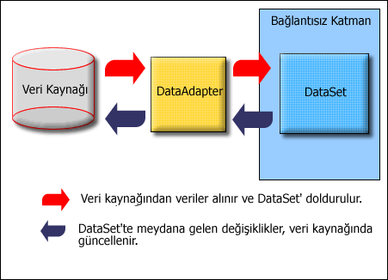
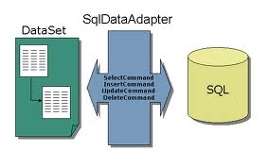
DataSet, DataTable and DataAdapter
DataSet: equivalent of an in-memory database.
It consists of a collection of DataTables.
DataTables are created by a DataAdapter (i.e. SqlDataAdapter).
DataSet doesn’t interact with databases directly.
DataAdapter reads the physical data sources and fills DataTables and DataSets.

Slide 15
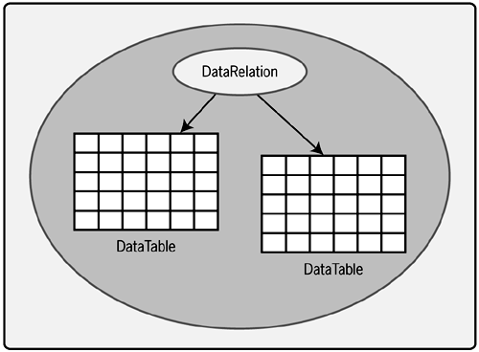
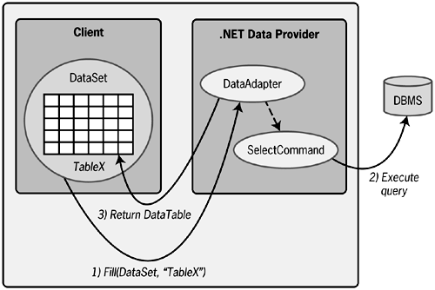
DataSet, DataTable and DataAdapter
A DataSet contains DataTables
Calling a DataAdapter's Fill method causes the associated SelectCommand to be executed and the results placed in a DataSet as a DataTable.
A DataAdapter's Fill method can be used to execute a query and store the result in a DataSet.

Slide 16
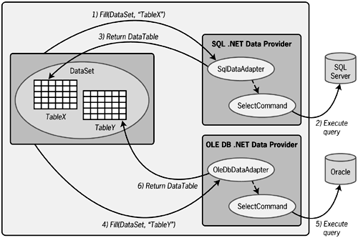
DataSet, DataTable and DataAdapter
A single DataSet can contain DataTables whose contents are derived from different databases.

Slide 17
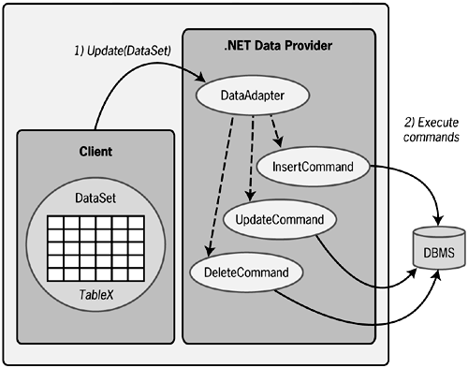
DataSet, DataTable and DataAdapter
Calling DataAdapter's Insert – Delete - Update methods updates the DBMS to reflect any changes made to a DataSet.

Slide 18
ADO.NET Data Providers
Connection
To establish a connection to a data source.
Command
To execute SQL commands and stored procedures.
DataAdapter
To fill a DataSet with information extracted from a data source.
To apply changes to a data source, according to the modifications you’ve made in a DataSet.

Slide 19
ADO.NET Data Providers
SQL Server provider: Provides optimized access to a SQL Server database
OLE DB provider: Provides access to any data source that has an OLE DB driver such as MS Access, MySQL
Oracle provider: Provides optimized access to an Oracle database
ODBC provider: Provides access to any data source that has an ODBC driver.

Slide 20
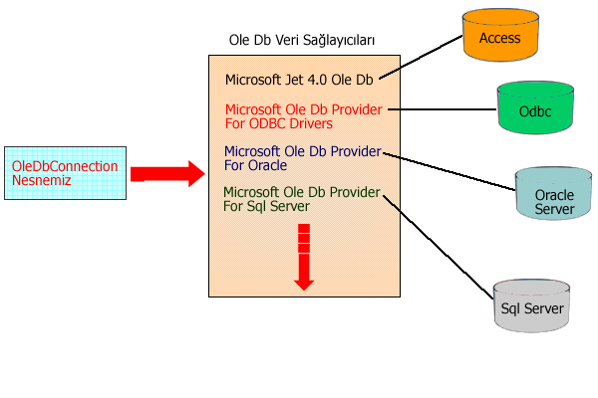
ADO.NET Data Providers

Slide 21
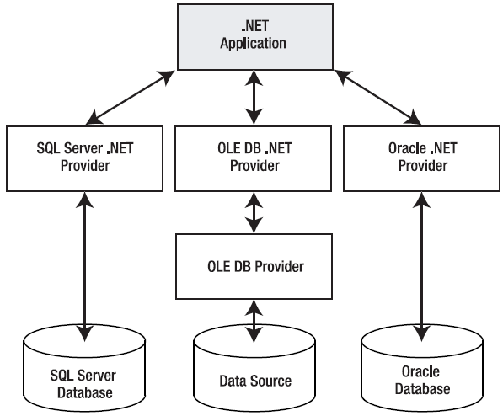
ADO.NET Data Providers
The layers of the ADO.NET provider model

Slide 22
The ADO.NET Namespace
Namespace | Description
System.Data | Contains the key data container classes that model columns, relations, tables, datasets, rows, views, and constraints.
System.Data.OleDb | Contains the classes used to connect to an OLE DB provider, including OleDbCommand, OleDbConnection, OleDbDataReader, and OleDbDataAdapter.
System.Data.SqlClient | Contains the classes you use to connect to a Microsoft SQL Server database, including SqlCommand, SqlConnection, SqlDataReader, and SqlDataAdapter.
System.Data.OracleClient | Contains the classes required to connect to an Oracle database, including OracleCommand, OracleConnection, OracleDataReader, and OracleDataAdapter.
System.Data.Odbc | Contains the classes required to connect to most ODBC drivers, including OdbcCommand, OdbcConnection, OdbcDataReader, and OdbcDataAdapter.

Slide 23
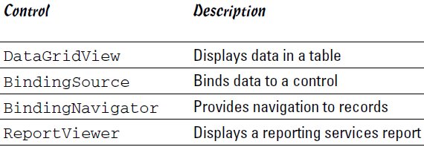
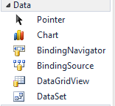

Displaying Data in Windows Forms

Slide 24
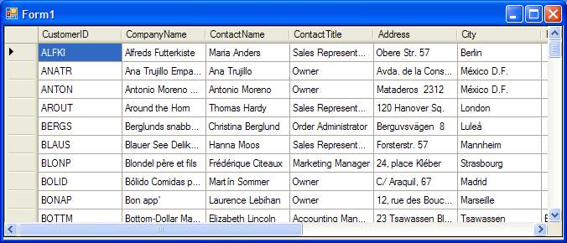
DataGridView
Grid control for showing large tables of information.
It supports selecting, editing, and sorting.
It provides a DataSource property for the data object.
Select the fields (columns) to be displayed and their header texts.

Slide 25
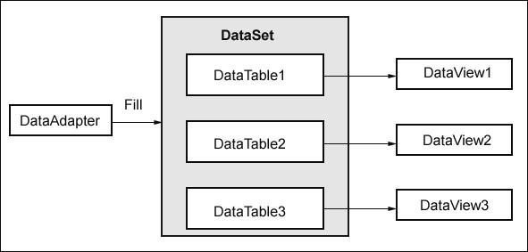
DataGridView
Use DataAdapter to get data from the database.
Fill the data into a DataSet
Bind the DataTable in DataSet to a DataGridView

Slide 26
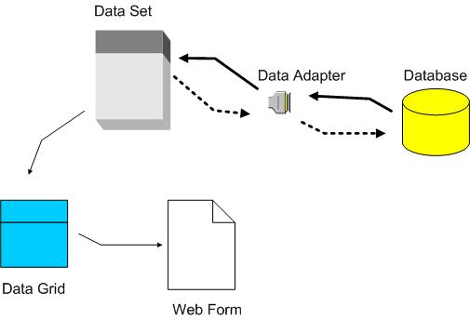
DataGridView
Windows

Slide 27
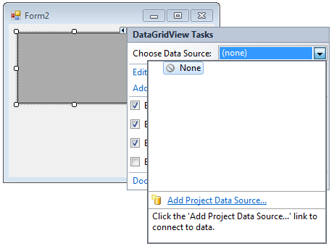
Adding data to Windows Applications
Create a new Windows application.
Drag and drop a DataGridView from toolbox
Click the arrow in the upper-right corner of the DataGridView
Click the Choose Data Source drop-down list.

Slide 28
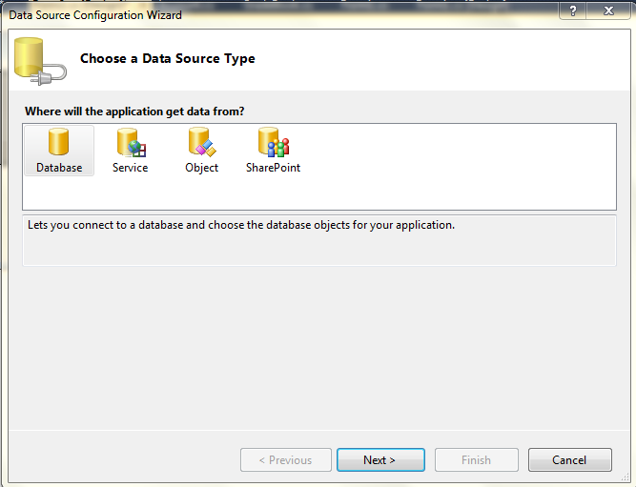
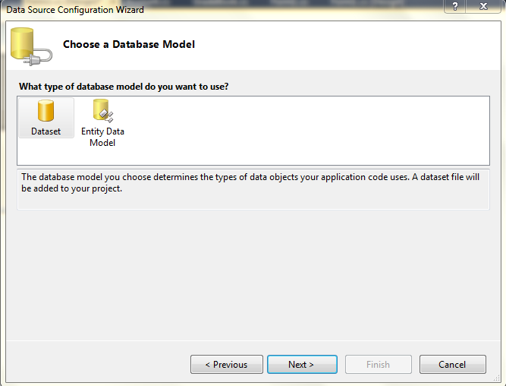
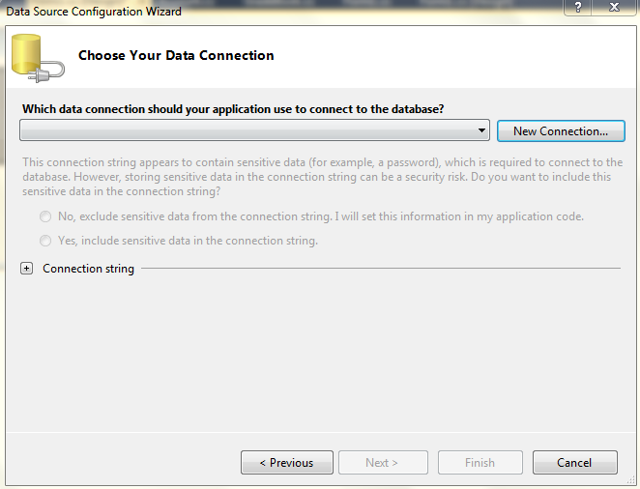
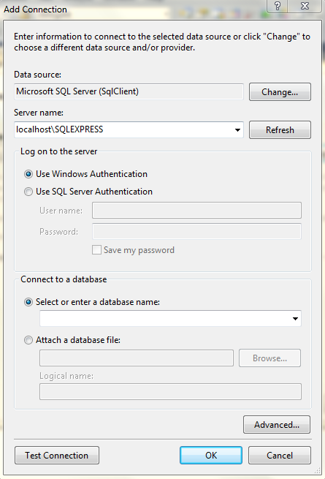
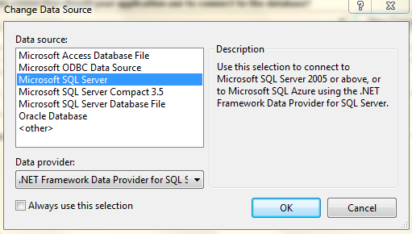
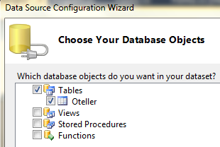
Click the Database icon
Click Dataset icon
Click the New Connection button
Make sure that the Data Source field is set to Microsoft SQL Server
Append localhost\SQLExpress to the server name and use Windows Authentication radio button
Select a Database and a Table
1
3
5
2
4
6

Slide 29
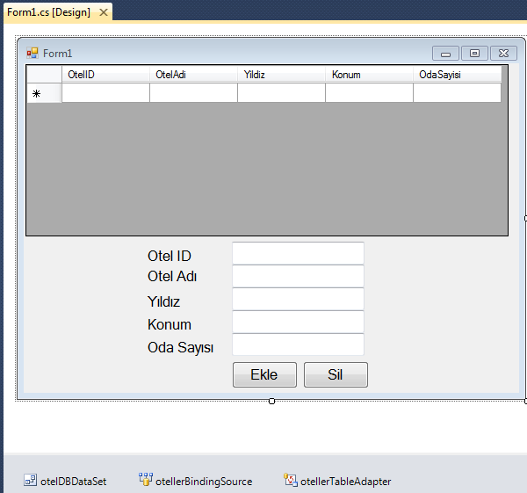
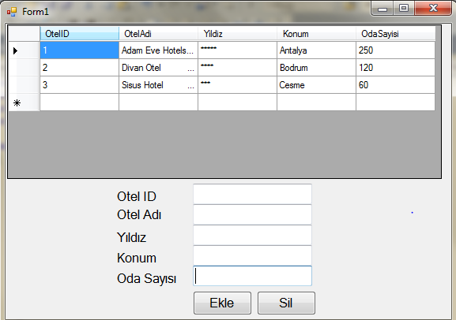
Let’s Do It!

Slide 30
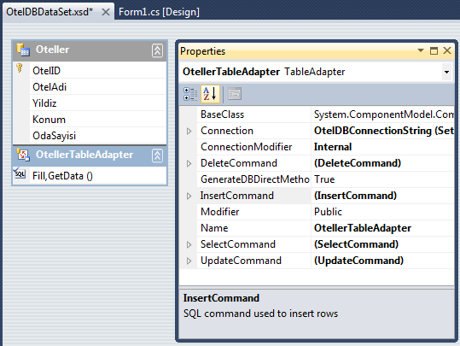
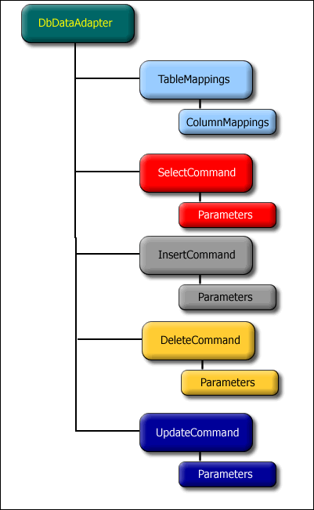
Let’s Do It!
Use InsertCommand and DeleteCommand of TableAdapter

Slide 31
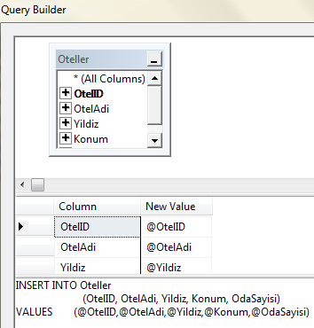
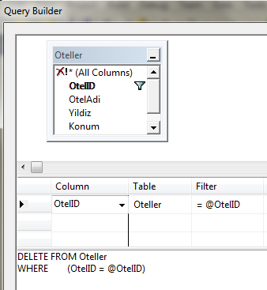
INSERT INTO Oteller
(OtelID, OtelAdi, Yildiz, Konum, OdaSayisi)
VALUES (@OtelID,@OtelAdi,@Yildiz,@Konum,@OdaSayisi)
DELETE FROM Oteller
WHERE (OtelID = @OtelID)

Slide 32
private void Form1_Load(object sender, EventArgs e)
{
otellerTableAdapter.Fill(otelDBDataSet.Oteller);
}
private void button1_Click(object sender, EventArgs e) //EKLEME
{
otellerTableAdapter.Insert(Convert.ToInt16(textBox1.Text),
textBox2.Text,
textBox3.Text,
textBox4.Text,
Convert.ToInt16(textBox5.Text));
otellerTableAdapter.Fill(otelDBDataSet.Oteller);
}
private void button2_Click(object sender, EventArgs e) //SİLME
{
otellerTableAdapter.Delete(Convert.ToInt16(textBox1.Text));
otellerTableAdapter.Fill(otelDBDataSet.Oteller);
}
private void dataGridView1_Click(object sender, EventArgs e)
{
textBox1.Text = dataGridView1.CurrentRow.Cells[0].Value.ToString();
textBox2.Text = dataGridView1.CurrentRow.Cells[1].Value.ToString();
textBox3.Text = dataGridView1.CurrentRow.Cells[2].Value.ToString();
textBox4.Text = dataGridView1.CurrentRow.Cells[3].Value.ToString();
textBox5.Text = dataGridView1.CurrentRow.Cells[4].Value.ToString();
}

Slide 33
Pattern of Database Programming
Create a connection object.
Open the connection.
Create a command object.
Execute the command.
Access the data.
Close the connection.

Slide 34
Connection Strings
The connection string is a series of name/value settings separated by semicolons (;).
It specifies the basic information needed to create a connection.
The order of these settings is unimportant, as is the capitalization.
Three parts:
  The server where the database is located
  The database you want to use
  How the database should authenticate you
Example:
  "Data Source=localhost; Initial Catalog=Northwind; Integrated Security=SSPI"

Slide 35
Connection Strings
Logged-in Windows user:
  "Data Source=localhost; Initial Catalog=Northwind; Integrated Security=SSPI"
SQL Server EXPRESS database
"Data Source=localhost\SQLEXPRESS; Initial Catalog=Northwind; Integrated Security=True"
SQL Server database, the sa (system administrator) account
"Data Source=localhost; Initial Catalog=Northwind; user id=sa; password=de"
Connects to an Access database file
"Provider=Microsoft.Jet.OLEDB.4.0; Data Source=C:\DS\Northwind.mdb"
Supply the file name of the database in the App_Data directory
"Data Source=localhost\SQLEXPRESS; Integrated Security=SSPI; AttachDBFilename=Northwind.mdf; User Instance=True""

Slide 36
Testing a Connection
1. Define the connection string
2. Use Open() and Close() methods (manage the connection)
string connectionStr = "Data Source=localhost\\SQLEXPRESS;
Initial Catalog=OtelDB;
Integrated Security=True";
SqlConnection con = new SqlConnection(connectionStr);
con.Open();
con.Close();

Slide 37
The Command Class
The Command class allows you to execute any type of SQL statement.
It is used to perform
  data definition tasks
    such as creating and altering databases, tables, and indexes
  data manipulation tasks
    such as retrieving and updating the records in a table

Slide 38

Command Basics
Before you can use a command
  Bind the command to a Connection.
  Set the CommandText
Example:
string connectionStr = "Data Source=localhost\\SQLEXPRESS;Initial
Catalog=OtelDB;Integrated Security=True";
SqlConnection con = new SqlConnection(connectionStr);
SqlCommand cmd = new SqlCommand(connectionStr, con);
cmd.CommandText = "SELECT * FROM Oteller";

Slide 39
To Execute a Command
To execute a command:
ExecuteNonQuery()
Executes SQL commands that insert, delete, or update records.
ExecuteScalar()
Executes a SELECT query and returns a single value such as COUNT() or SUM()

Slide 40
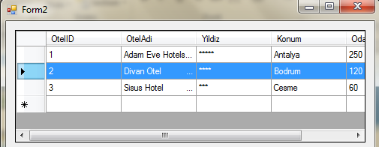
Let’s Do It!
Write code to get data from a database table
  Solution 1 : Use datatable directly
  Solution 2 : Use dataset

Slide 41
private void Form2_Load(object sender, EventArgs e)
{
string connectionStr = "Data Source=localhost\\SQLEXPRESS;Initial
Catalog=OtelDB;Integrated Security=True";
SqlConnection con = new SqlConnection(connectionStr);
con.Open();
SqlCommand cmd = new SqlCommand(connectionStr, con);
cmd.CommandText = "SELECT * FROM Oteller";
SqlDataAdapter adap = new SqlDataAdapter(cmd);
DataTable dt = new DataTable();
adap.Fill(dt);
dataGridView1.DataSource = dt;
con.Close();
}
Solution 1: Using DataTable directly

Slide 42
private void Form2_Load(object sender, EventArgs e)
{
string connectionStr = "Data Source=localhost\\SQLEXPRESS;Initial
Catalog=OtelDB;Integrated Security=True";
SqlConnection con = new SqlConnection(connectionStr);
con.Open();
SqlCommand cmd = new SqlCommand(connectionStr, con);
cmd.CommandText = "SELECT * FROM Oteller";
SqlDataAdapter adap = new SqlDataAdapter(cmd);
DataSet ds = new DataSet();
adap.Fill(ds);
dataGridView1.DataSource = ds.Tables[0];
con.Close();
}
Solution 2: Using DataSet

Slide 43
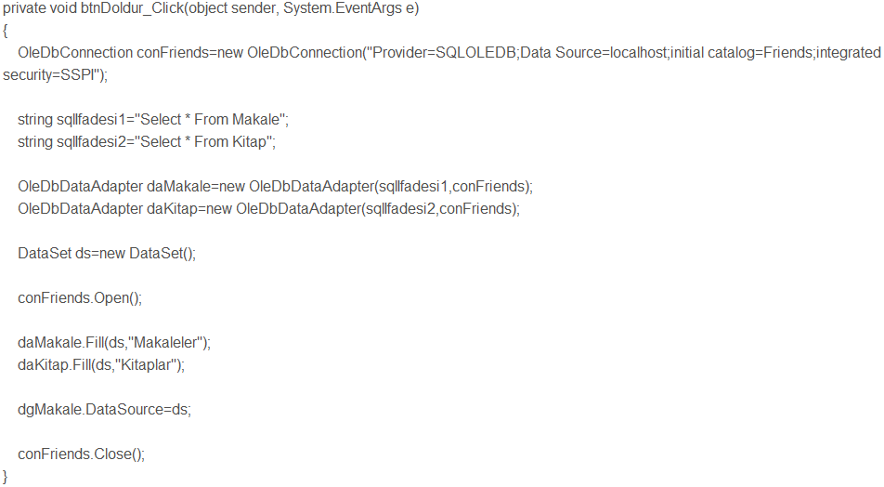
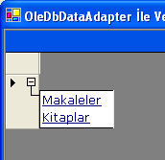
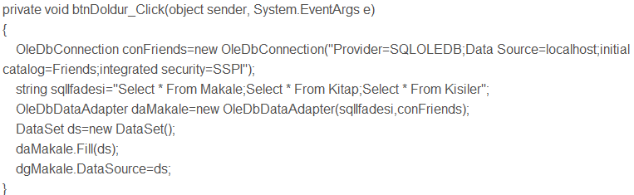
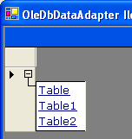

Slide 44
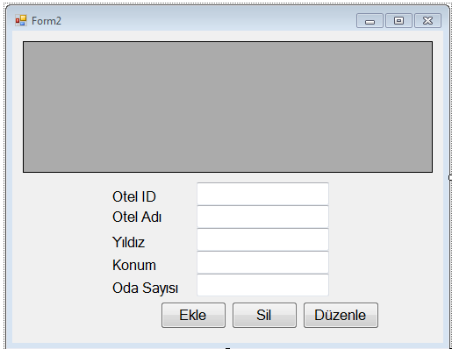
Let’s Do It!
Write code to execute sql insert – delete – update commands

Slide 45
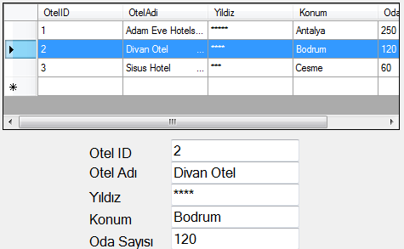
private void dataGridView1_Click(object sender, EventArgs e)
{
textBox1.Text = dataGridView1.CurrentRow.Cells[0].Value.ToString();
textBox2.Text = dataGridView1.CurrentRow.Cells[1].Value.ToString();
textBox3.Text = dataGridView1.CurrentRow.Cells[2].Value.ToString();
textBox4.Text = dataGridView1.CurrentRow.Cells[3].Value.ToString();
textBox5.Text = dataGridView1.CurrentRow.Cells[4].Value.ToString();
}

Slide 46
private void button1_Click(object sender, EventArgs e) //EKLEME
{
string connectionStr = "Data Source=localhost\\SQLEXPRESS;Initial
Catalog=OtelDB;Integrated Security=True";
SqlConnection con = new SqlConnection(connectionStr);
con.Open();
SqlCommand cmd = new SqlCommand(connectionStr, con);
cmd.CommandText = "INSERT INTO Oteller (OtelID, OtelAdi, Yildiz, Konum,
OdaSayisi) VALUES ('" + textBox1.Text + "','" +
textBox2.Text + "','" +
textBox3.Text + "','" +
textBox4.Text + "','" +
textBox5.Text + "')";
cmd.ExecuteNonQuery();
cmd.CommandText = "SELECT * FROM Oteller";
SqlDataAdapter adap = new SqlDataAdapter(cmd);
DataTable dt = new DataTable();
adap.Fill(dt);
dataGridView1.DataSource = dt;
con.Close();
}

Slide 47
private void button2_Click(object sender, EventArgs e) //SİLME
{
string connectionStr = "Data Source=localhost\\SQLEXPRESS;Initial
Catalog=OtelDB;Integrated Security=True";
SqlConnection con = new SqlConnection(connectionStr);
con.Open();
SqlCommand cmd = new SqlCommand(connectionStr, con);
cmd.CommandText = "DELETE FROM Oteller WHERE OtelID = '" + textBox1.Text + "'";
cmd.ExecuteNonQuery();
cmd.CommandText = "SELECT * FROM Oteller";
SqlDataAdapter adap = new SqlDataAdapter(cmd);
DataTable dt = new DataTable();
adap.Fill(dt);
dataGridView1.DataSource = dt;
con.Close();
}

Slide 48
private void button3_Click(object sender, EventArgs e) //DÜZENLEME
{
string connectionStr = "Data Source=localhost\\SQLEXPRESS;Initial
Catalog=OtelDB;Integrated Security=True";
SqlConnection con = new SqlConnection(connectionStr);
con.Open();
SqlCommand cmd = new SqlCommand(connectionStr, con);
cmd.CommandText = "UPDATE Oteller SET OtelAdi = '" + textBox2.Text + "' , " +
"Yildiz = '" + textBox3.Text + "' , " +
"Konum = '" + textBox4.Text + "' , " +
"OdaSayisi = '" + textBox5.Text + "' " +
"WHERE OtelID = '" + textBox1.Text + "'";
cmd.ExecuteNonQuery();
cmd.CommandText = "SELECT * FROM Oteller";
SqlDataAdapter adap = new SqlDataAdapter(cmd);
DataTable dt = new DataTable();
adap.Fill(dt);
dataGridView1.DataSource = dt;
con.Close();
}

Slide 49
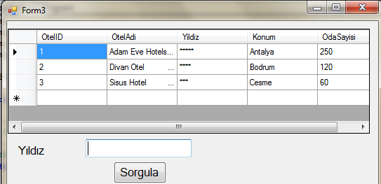
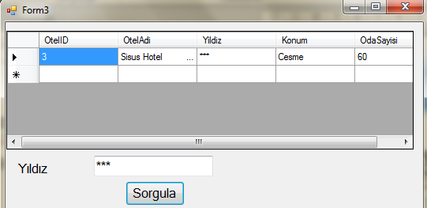
Let’s Do It !
Write the following query

Slide 50
private void button1_Click(object sender, EventArgs e)
{
string connectionStr = "Data Source=localhost\\SQLEXPRESS;Initial
Catalog=OtelDB;Integrated Security=True";
SqlConnection con = new SqlConnection(connectionStr);
con.Open();
SqlCommand cmd = new SqlCommand(connectionStr, con);
cmd.CommandText = "SELECT * FROM Oteller WHERE yildiz='" + textBox1.Text + "'";
SqlDataAdapter adap = new SqlDataAdapter(cmd);
DataTable dt = new DataTable();
adap.Fill(dt);
dataGridView1.DataSource = dt;
con.Close();
}

Slide 51
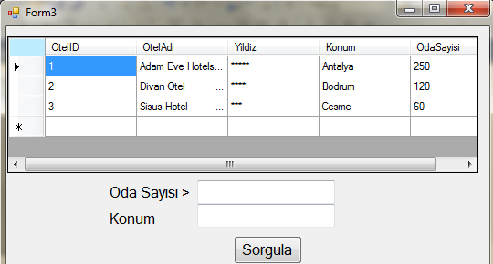
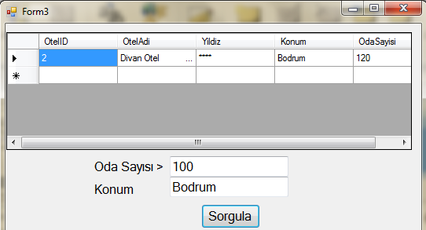
Let’s Do It !

Slide 52
private void button2_Click(object sender, EventArgs e)
{
string connectionStr = "Data Source=localhost\\SQLEXPRESS;Initial
Catalog=OtelDB;Integrated Security=True";
SqlConnection con = new SqlConnection(connectionStr);
con.Open();
SqlCommand cmd = new SqlCommand(connectionStr, con);
cmd.CommandText = "SELECT * FROM Oteller WHERE odasayisi > '" + textBox2.Text
+ "' and Konum= '" + textBox3.Text + "'";;
SqlDataAdapter adap = new SqlDataAdapter(cmd);
DataTable dt = new DataTable();
adap.Fill(dt);
dataGridView1.DataSource = dt;
con.Close();
}

Slide 53
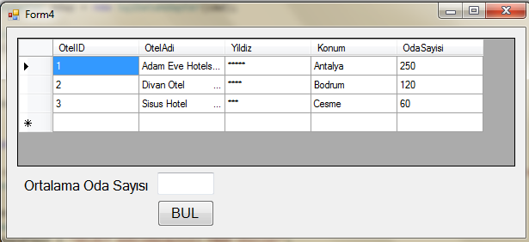
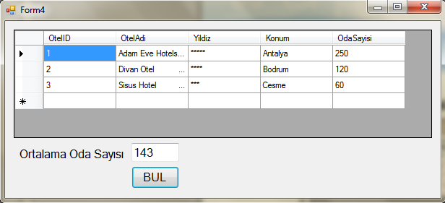
Let’s Do It !
Don’t forget to use ExecuteScalar()
ExecuteScalar()
Executes a SELECT query and returns a single value such as COUNT(), AVG() or SUM()

Slide 54
private void button1_Click(object sender, EventArgs e)
{
string connectionStr = "Data Source=localhost\\SQLEXPRESS;Initial
Catalog=OtelDB;Integrated Security=True";
SqlConnection con = new SqlConnection(connectionStr);
con.Open();
SqlCommand cmd = new SqlCommand(connectionStr, con);
cmd.CommandText = "SELECT AVG(odasayisi) FROM Oteller";
textBox1.Text = cmd.ExecuteScalar().ToString();
con.Close();
}

Slide 55
Global Connection Strings
Store the connection strings in app.config file
Add this reference to your project C:\WINDOWS\Microsoft.NET\Framework\v4.0.30319\System.configuration.dll
Retrieve it using ConfigurationManager.ConnectionStrings
<?xml version="1.0" encoding="utf-8" ?>
<configuration>
<configSections>
</configSections>
<connectionStrings>
<add name="myDBConnection"
connectionString="Data Source=localhost\SqlExpress;Initial
Catalog=OtelDB;Integrated Security=True"
providerName="System.Data.SqlClient" />
</connectionStrings>
</configuration>
string connectionStr = ConfigurationManager.ConnectionStrings["MyDBConnection"].ConnectionString;

Slide 56
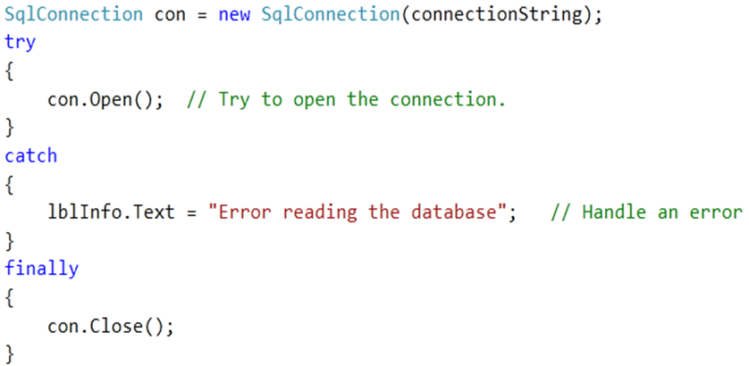
Handling Connection Errors
1. Define the connection string
2. Use Open() and Close() methods (manage the connection)

Slide 57
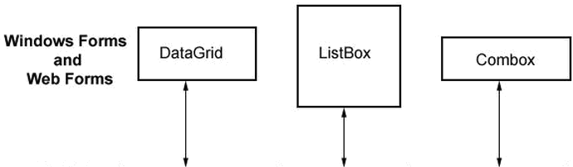
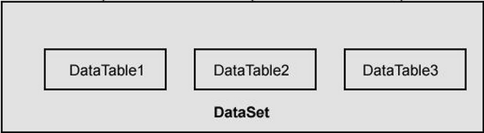

Binding ListBox, ComboBox
Use DataAdapter to get data from the database.
Fill the data into a DataSet
Bind the DataTable in DataSet to a ListBox or ComboBox using DataSource and DisplayMember properties

Slide 58
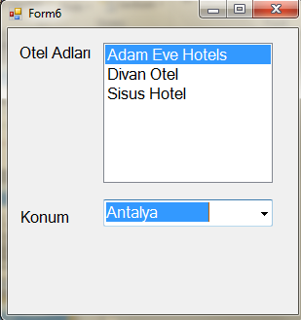
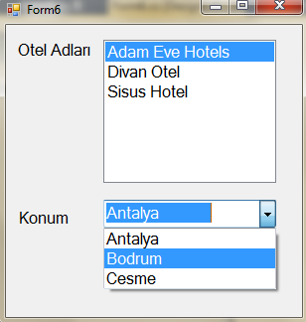
Let’s Do It !

Slide 59
private void Form6_Load(object sender, EventArgs e)
{
string connectionStr = "Data Source=localhost\\SQLEXPRESS;Initial
Catalog=OtelDB;Integrated Security=True";
SqlConnection con = new SqlConnection(connectionStr);
con.Open();
SqlCommand cmd = new SqlCommand(connectionStr, con);
cmd.CommandText = "SELECT * FROM Oteller";
SqlDataAdapter adap = new SqlDataAdapter(cmd);
DataTable dt = new DataTable();
adap.Fill(dt);
listBox1.DataSource = dt;
listBox1.DisplayMember = "OtelAdi";
comboBox1.DataSource = dt;
comboBox1.DisplayMember = "Konum";
con.Close();
}

Slide 60
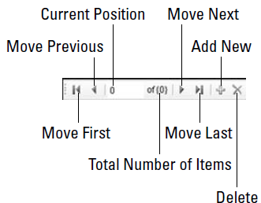

Using BindingNavigator
The BindingNavigator component is a built-in menu control for navigating data.
The control includes the following buttons (from left to right) for navigating and manipulating data:
The BindingNavigator component is used in conjunction with BindingSource.

Slide 61

Let’s Do It!

Slide 62
private void Form7_Load(object sender, EventArgs e)
{
string connectionStr = "Data Source=localhost\\SQLEXPRESS;Initial
Catalog=OtelDB;Integrated Security=True";
SqlConnection con = new SqlConnection(connectionStr);
con.Open();
SqlCommand cmd = new SqlCommand(connectionStr, con);
cmd.CommandText = "SELECT * FROM Oteller";
SqlDataAdapter adap = new SqlDataAdapter(cmd);
DataTable dt = new DataTable();
adap.Fill(dt);
bindingSource1.DataSource = dt;
dataGridView1.DataSource = bindingSource1;
con.Close();
}

Slide 63
See you next week!
Asst.Prof.Dr.Derya BİRANT
329 - Windows Programming

